Slide 1
DETECTING UNPRODUCTIVE APPS(PLAY STORE) USING SENTIMENTAL ANALYSIS presented by: Karthik movva sai vinay Kumar rishi kolasani
Google play store and IOS store has many unworthy apps which are not useful for the user.
But, the ratings for these apps will be good enough so, that the user will think it’s a good one and start using it. But the end of the day user will realize it’s unworthy app. So, the only way user can know about the app is by looking at the other user comments but, not the rating. But, it’s a time consuming process. So, by using sentimental analysis we analyse the data in comments and find whether the app is productive or not.

Slide 2
How this is going to work?
By using data miner we will import the data from the user comments of an app (which we are going to find whether it’s productive or not).
Data is saved as a .CSV file.
Two dictionaries are created POSITIVE and NEGATIVE in the form of .XML files.
Using python code the data imported from the app comments is separated as words .these words are tagged and compared with the positive and negative dictionaries.
We will return the positive and negative tagged words as +1 and -1 and those values are looped and sum is calculated successfully.
At last if the sum is <”-15” app is unproductive else the app is productive.
example:
the words and their tags are as follows
+1,+1,-1,+1
sum=2
so, the app is PRODUCTIVE.

Slide 3
Methods involved
Importing
Importing the data from data miner
Separating
Filtering the data such as removing unnecessary characters and words and bringing the data into the way we need.
Creating
Creating the positive and negative dictionaries.
Comparing
Comparing the data obtained from the comments with the dictionaries and assigning tags to the words( positive and negative) using PYTHON.
Adding
Adding these positive and negative values of the tags and finding the sum , of the sum<“-15” the app is unproductive else the app is productive.
Pre-processing
Separating the comments alone excluding the details and name of the user

Slide 4
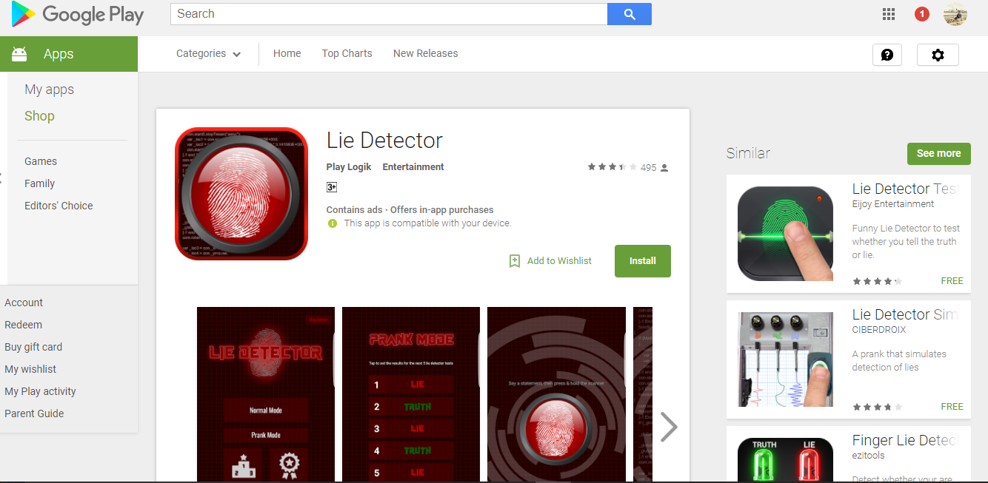
Importing the data using data miner
This is the app which we have chosen to do sentimental analysis. We have taken data from the comments of the users.

Slide 5
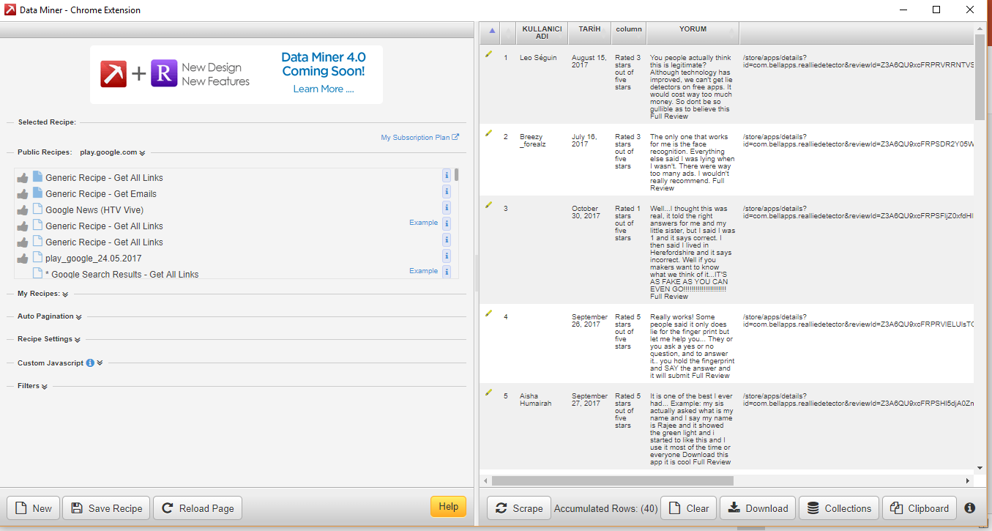
Data obtained from data miner.

Slide 6
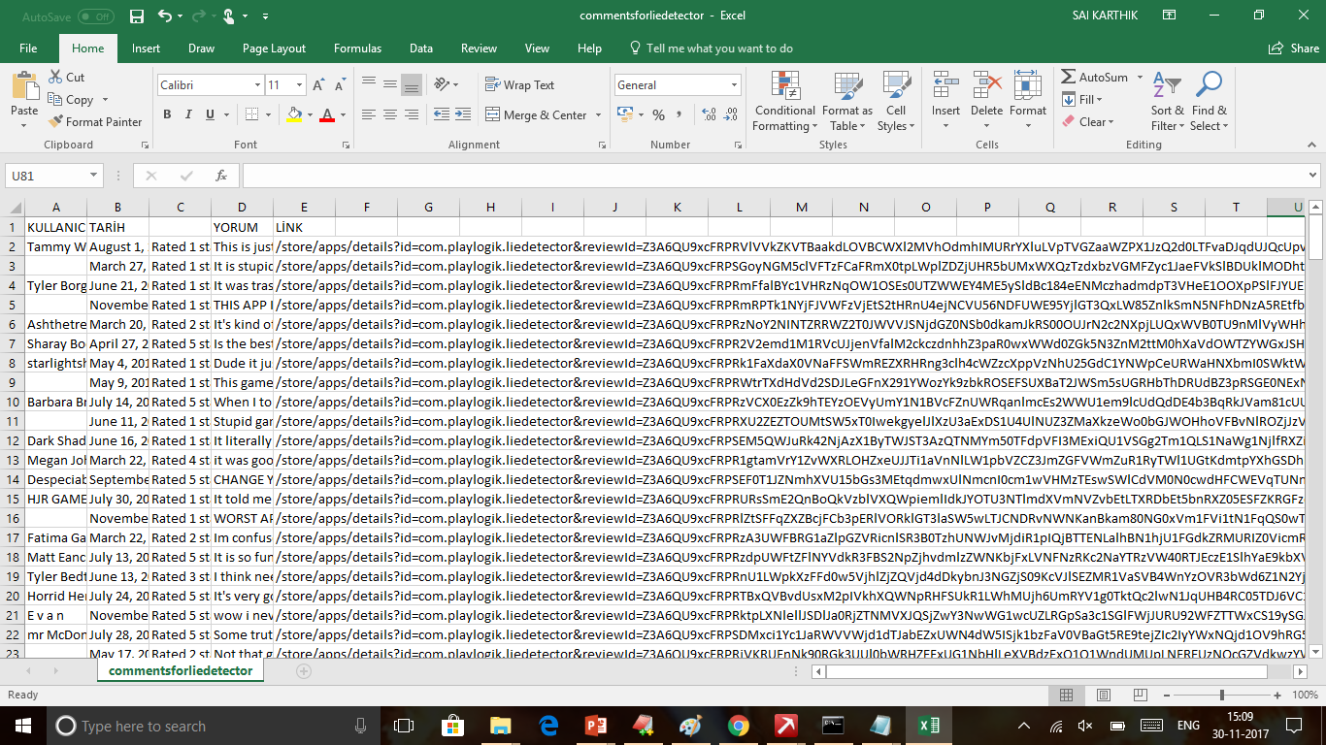
Filed obtained by downloading the data from data miner

Slide 7
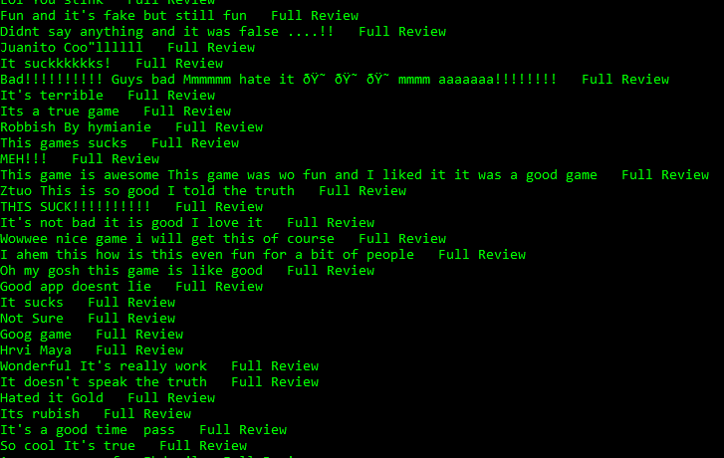
Raw data obtained by executing the python code.

Slide 8
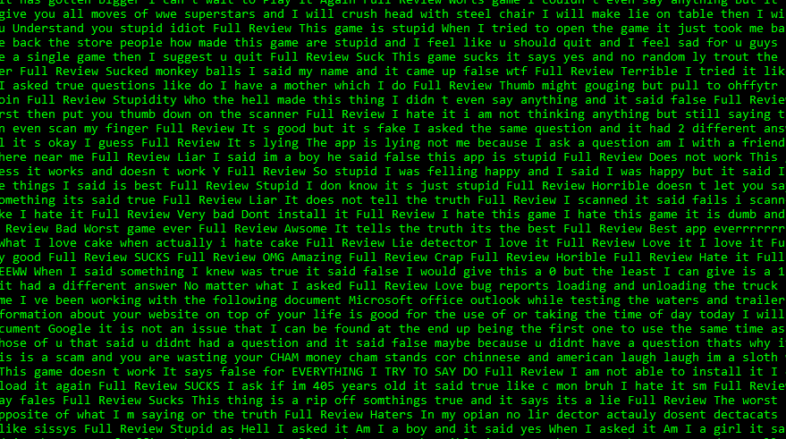
After processing the data

Slide 9

Splitting and tagging the data

Slide 10
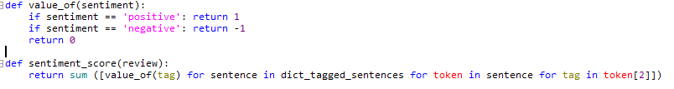
Summing the tags from the data and finding whether it is productive or not(code in python).

Slide 11

output

Slide 12
Tasks completed
Project proposed by : karthik movva
Phyton coding: karthik movva
Code testing and debugging : sai vinay Kumar koppola
Dictionaries created by :rishi kolasani.
Presentation done by : sai vinay, karthik and rishi kolasani.

Slide 13
Tasks remaining
In this process we have used data miner (google chrome extension) for extracting the data , we want to enhance it by extracting the data in the python itself by importing a module called BEAUTIFUL SOAP.
task handled to : karthik movva.
Creating another set of dictionaries and using them in order to compare the results:
task handled to : rishi kolasani and sai vinay.
Repeating the whole process on the another app called “RING TONE MAKER” , which is a productive app in order to compare the results.
task handled to : sai vinay and rishi kolasani

Slide 14
CONCLUSION
using the SENTIMENTAL ANALYSIS we can know the reliability of an app by not only considering it’s rating in the play store.

Slide 15
?
ANY QUERIES……

Slide 16
THANK YOU

